Slide 1
Jun 19 Update
Some findings on data

Slide 2
This week:
Reproduced bimodal distribution
Some findings on data
CVPR
Currently writing script for a label-involved AE

Slide 3
Re-encoder AE
MSE
Conv 1D
Maxpool
BiLSTM x3
Flatten
Reshape
BiLSTM x3
Upsample
Conv 2D
Conv 1D
Maxpool
BiLSTM x3
Flatten
MSE

Slide 4
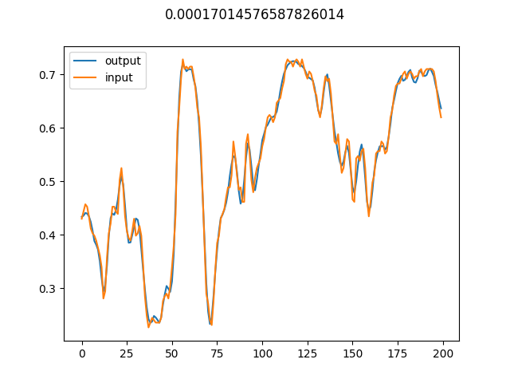
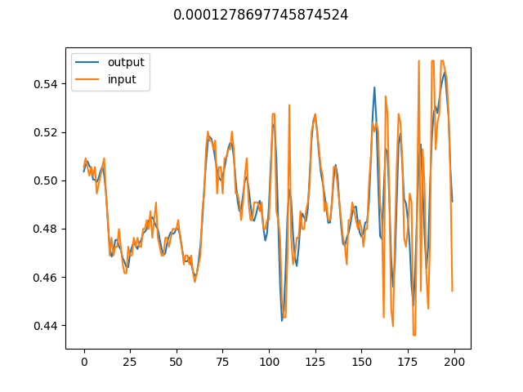
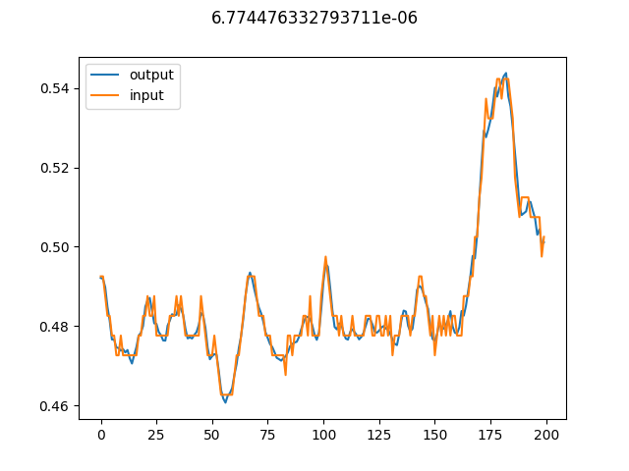
Results
Benign reconstruction: decent; struggles a little with super hi-freq

Slide 5
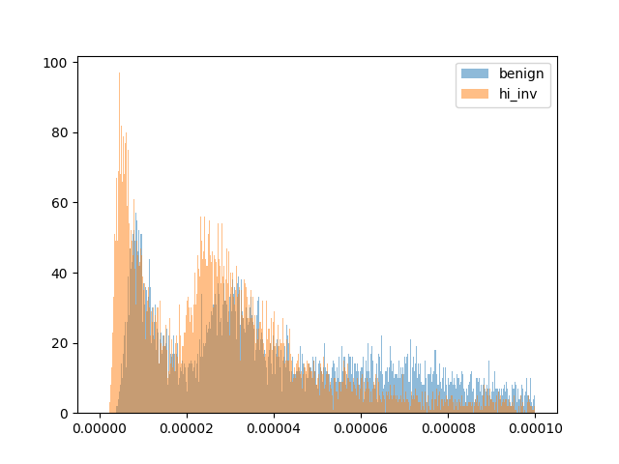
Results
Reproduced bimodal distribution

Slide 6
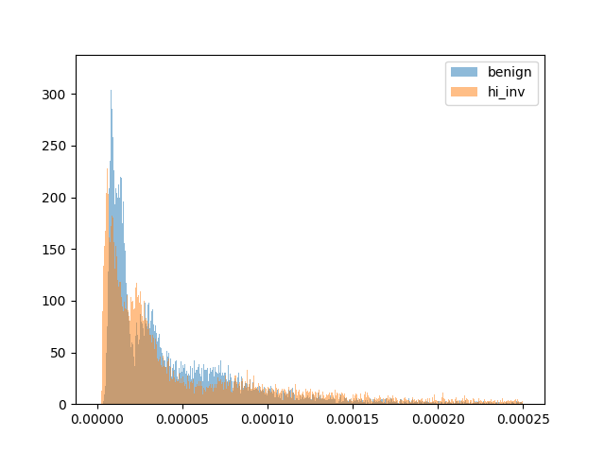
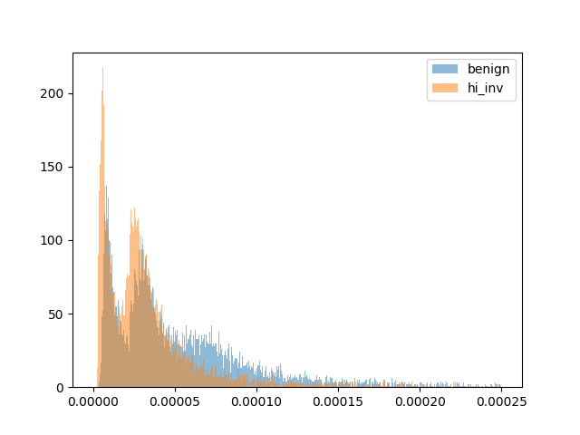
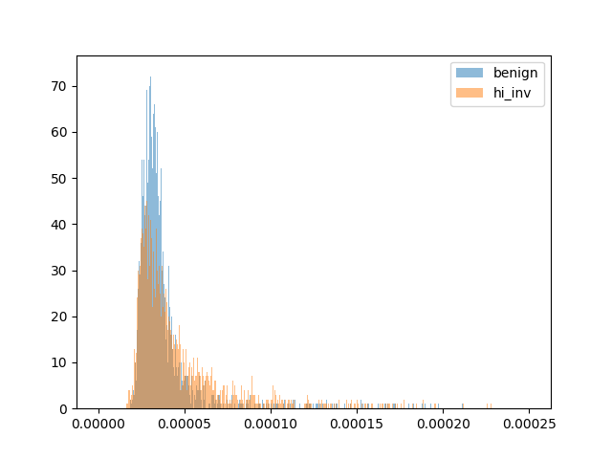
Results
Bimodal distribution with different involvement thresholds
Hi_inv = 0.2 or more
(25000 samples)
Hi_inv = 0.4 or more
(~18000 samples)
Hi_inv = 0.6 or more
(~4500 samples)
Hi_inv = 0.8 or more
(~4500 samples)

Slide 7
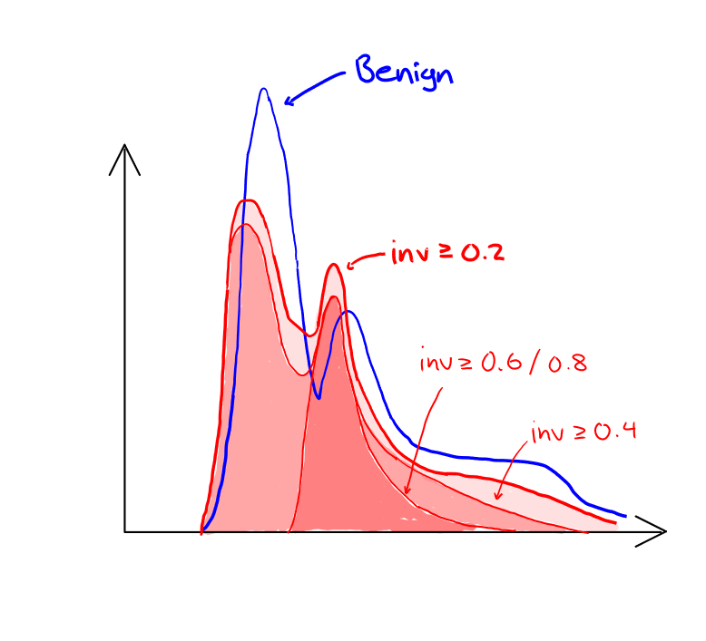
Results
Assumptions: benign distribution doesn’t change

Slide 8
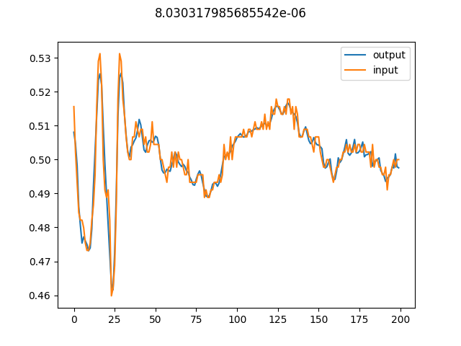
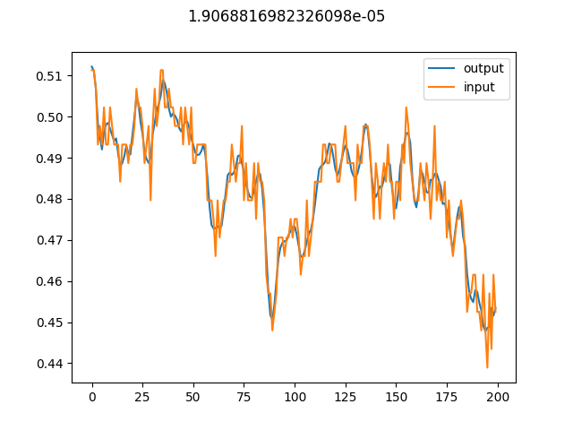
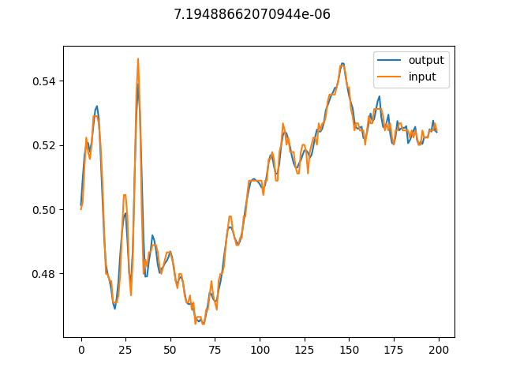
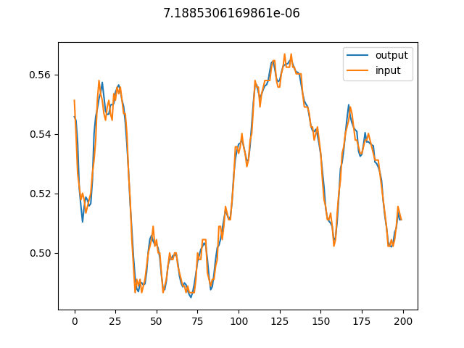
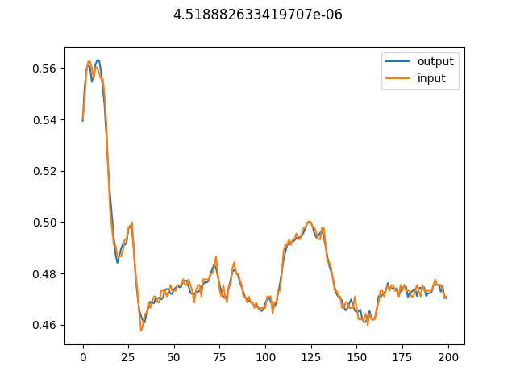
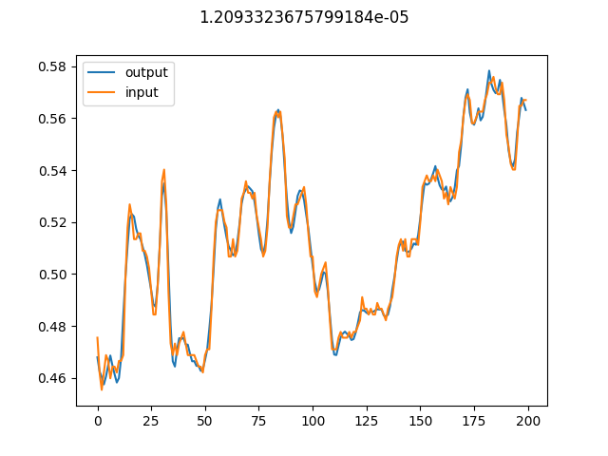
Results (cancer)
Low loss hump 0.0 – 0.00002

Slide 9
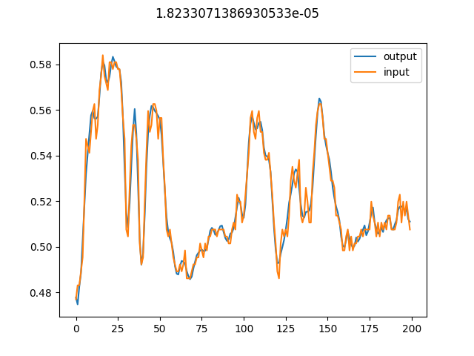
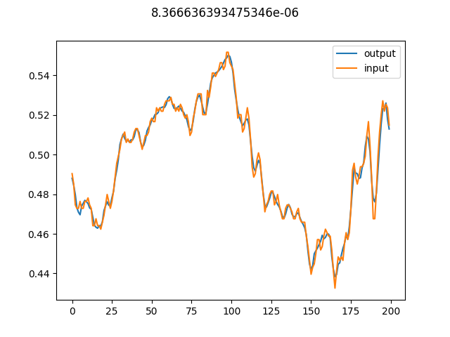
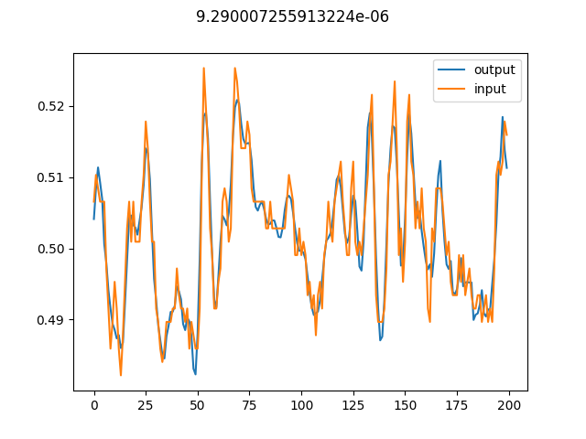
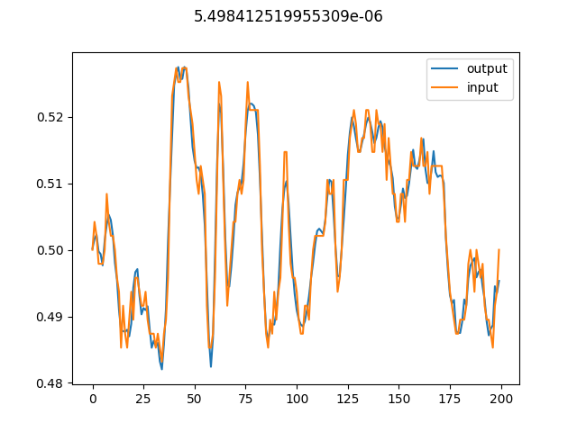
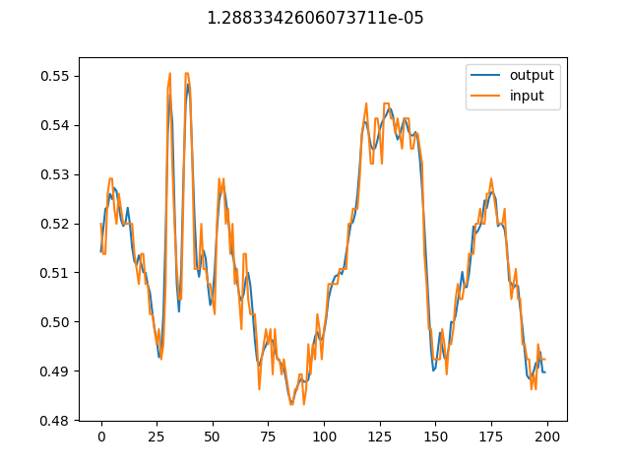
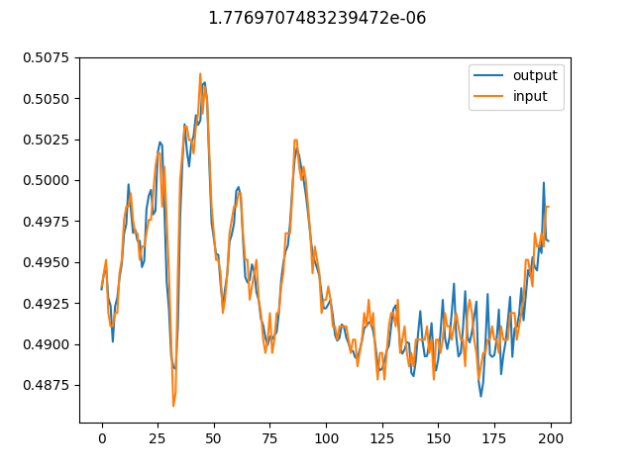
Results (benign)
Low loss hump 0.0 – 0.00002

Slide 10
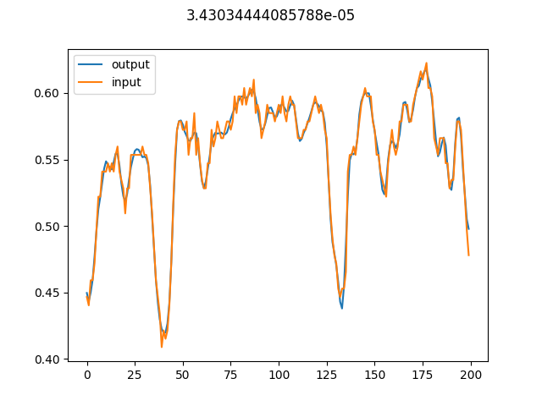
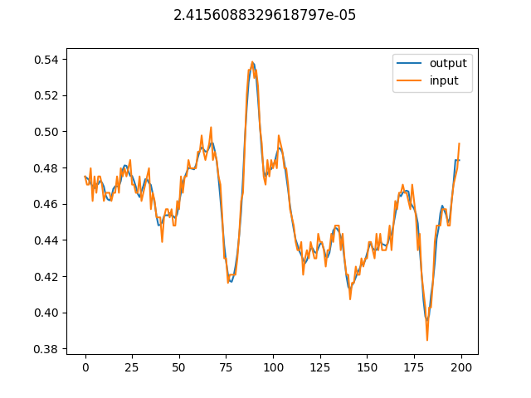
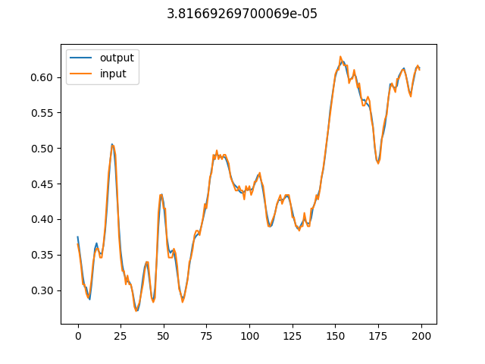
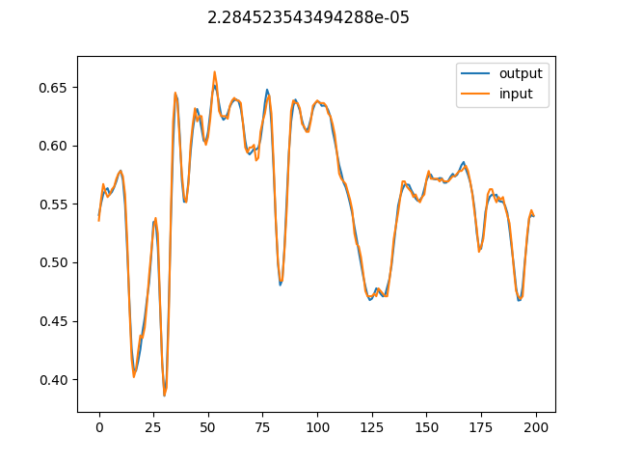
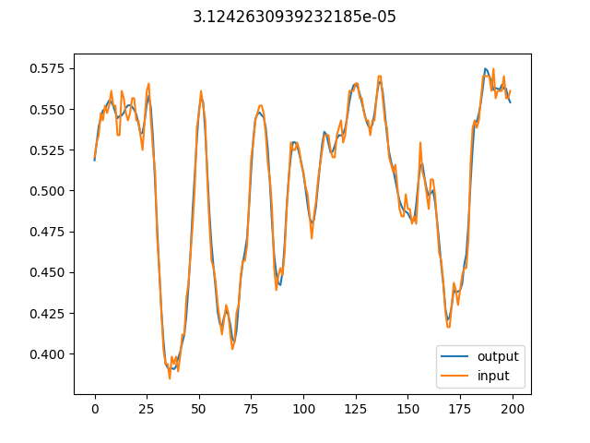
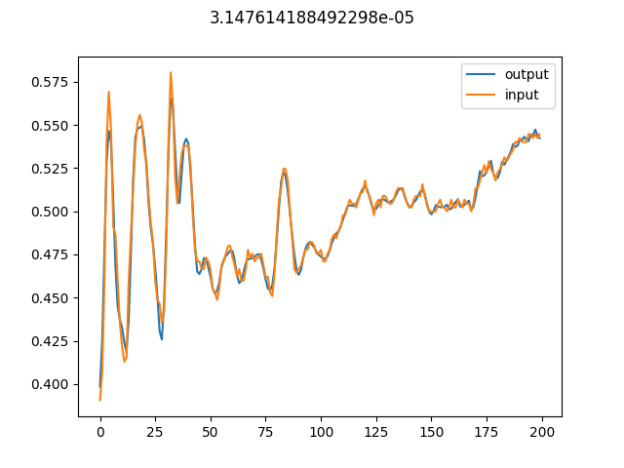
Results (cancer)
Higher loss hump 0.00002 – 0.00004

Slide 11
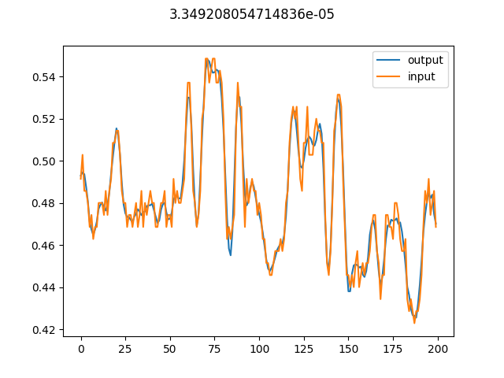
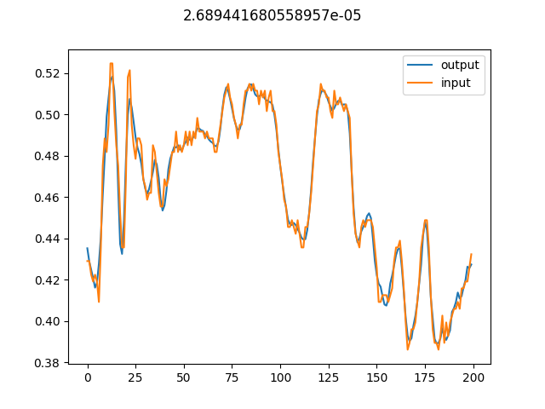
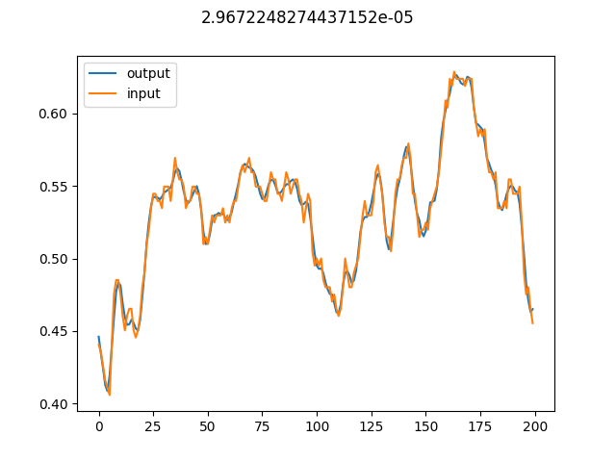
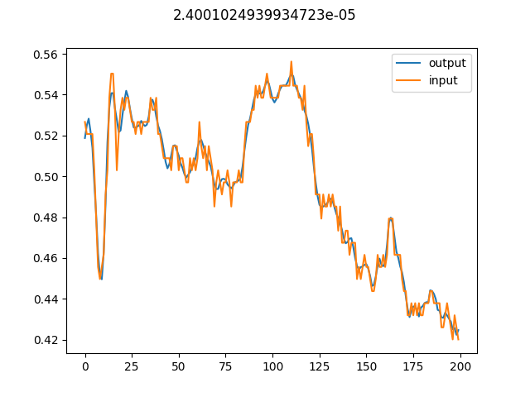
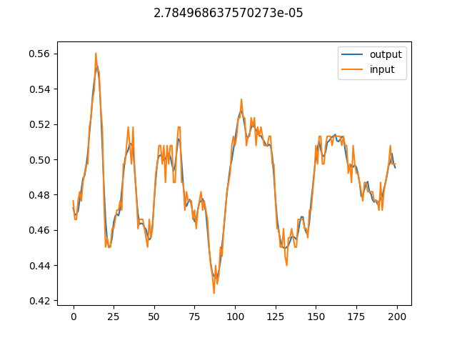
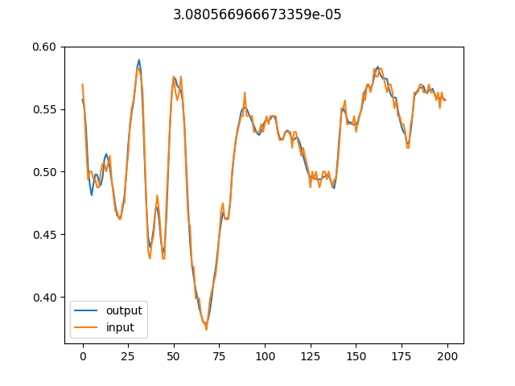
Results (benign)
Higher loss hump 0.00002 – 0.00004

Slide 12
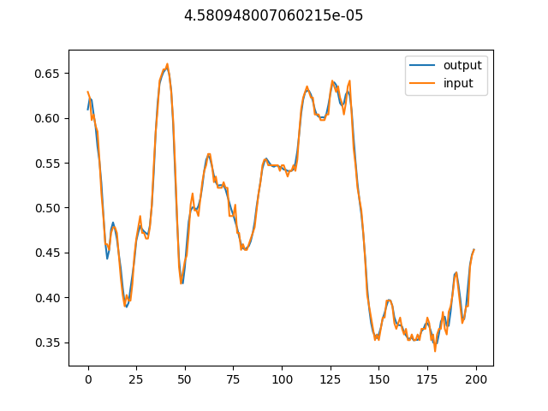
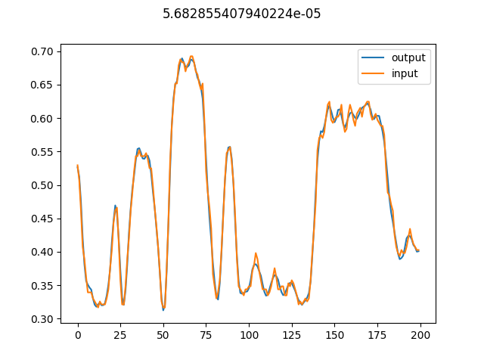
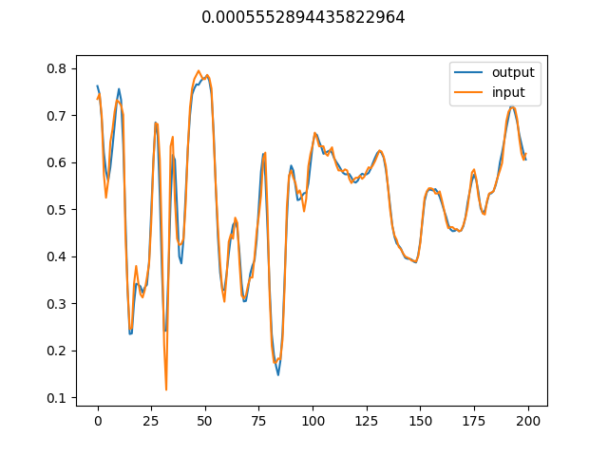
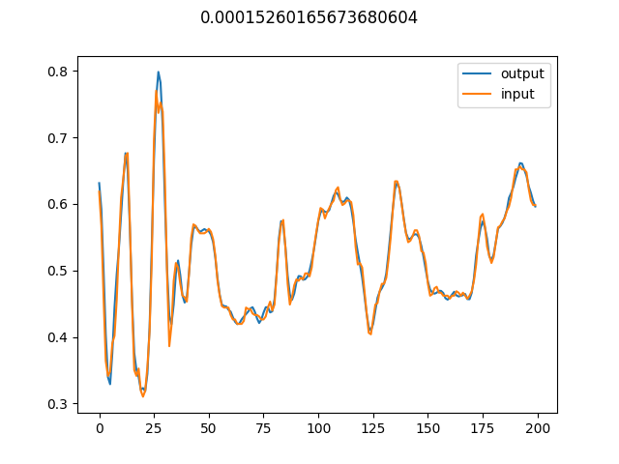
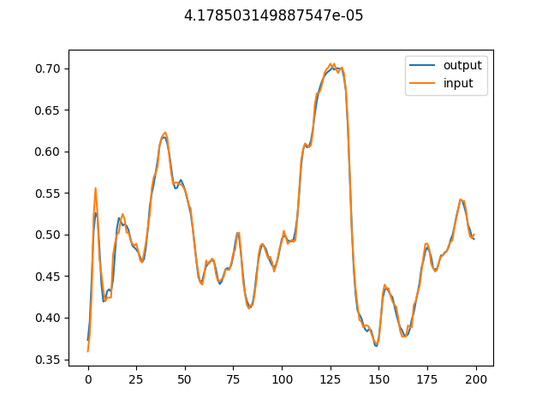
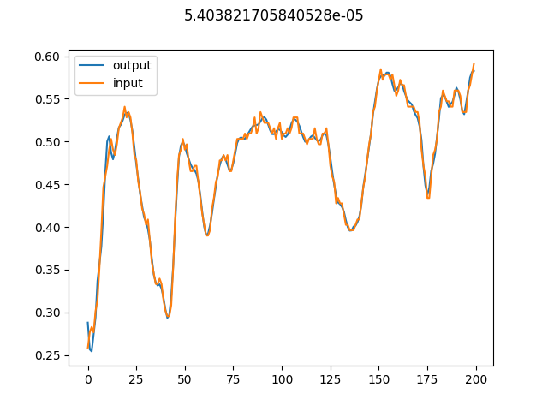
Results (cancer)
Tail > 0.00004

Slide 13
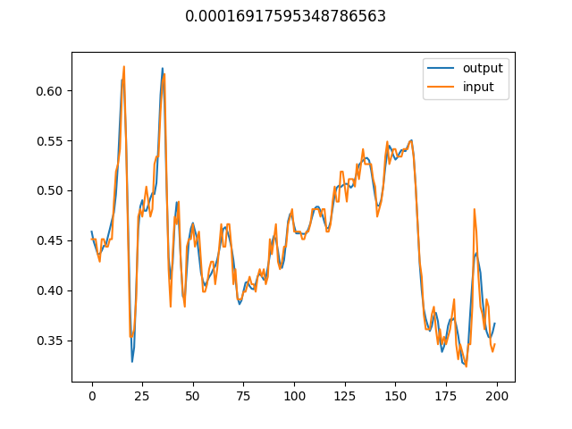
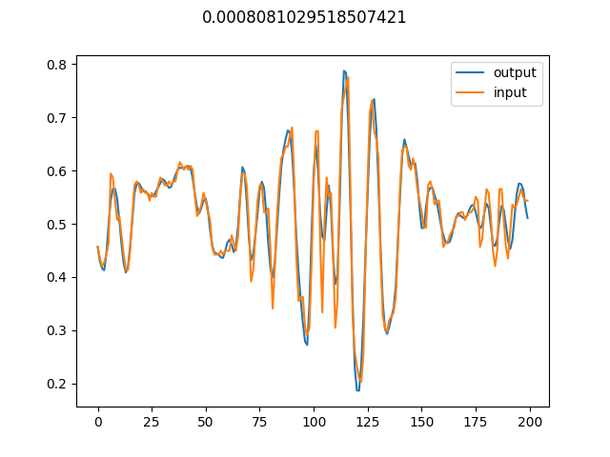
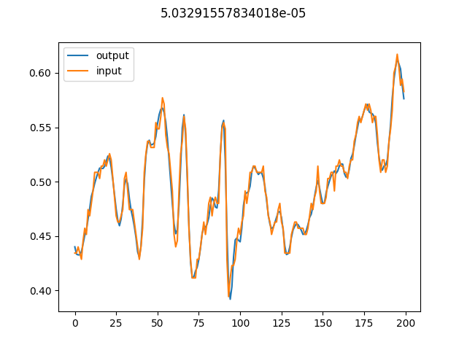
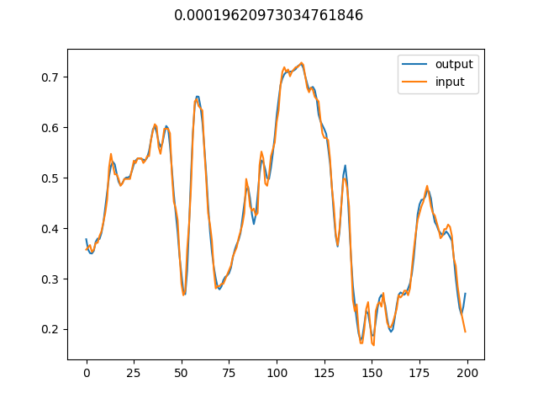
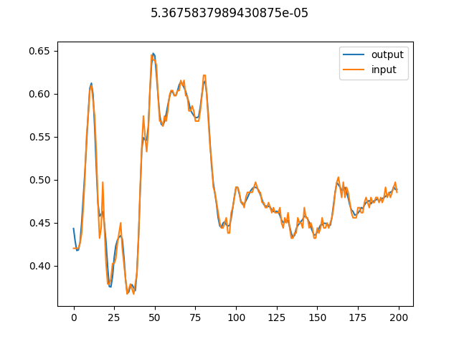
Results (benign)
Tail > 0.00004

Slide 14
Currently working on: AE with some labelling
Length n_latent
Multiply by:
00000….11111 if benign
11111….00000 if cancer
Encoder / decoder sees more data, hopefully improving performance
Shares “feature extractor”

Slide 15
Currently working on: AE with some labelling
Length n_latent
If cancer: loss = reconstruction loss using cancer-dedicated latent space + inverse of reconstruction loss using benign-dedicated latent space
If benign: loss = reconstruction loss using benign-dedicated latent space + inverse of reconstruction loss using cancer-dedicated latent space

Slide 16
Re-endoer AE + simple MIL (?) for core level classification
MSE
MSE
Classifier
Loss vec. for signals in core
Output = per-core classification
-> compare with labels

Slide 17
Next week
Read up on more AE architectures
Find a way to work around findings on our data

